Slide 1


Not so Immutable: Upgradeability of Smart Contracts on Ethereum
Mehdi Salehi
Jeremy Clark
Mohammad Mannan
WTSC’22, May 6, Virtual
Notes:
Hi There. I’m Mehdi master’s student in Concordia University in montreal canada and I’m very excited to share our recent research in title Not so immutable. Upgradeability of smart contracts on ethereum with you in WTSC workshop. And this is a joint work with my supervisors Dr. Jeremy clark and Dr Mohammad Mannan

Slide 2
Software Maintenance
1
2
Correct Faults Fixing a bug
Small Changes
Improve Performance New Functionalities
Upgrades
Updates
Notes:
In software engineering and software maintenance we have two important concepts: Updates happen when we need to correct faults, bugs or for small changes
But Upgrades happen to imporove code, performance and for adding new functionalities

Slide 3
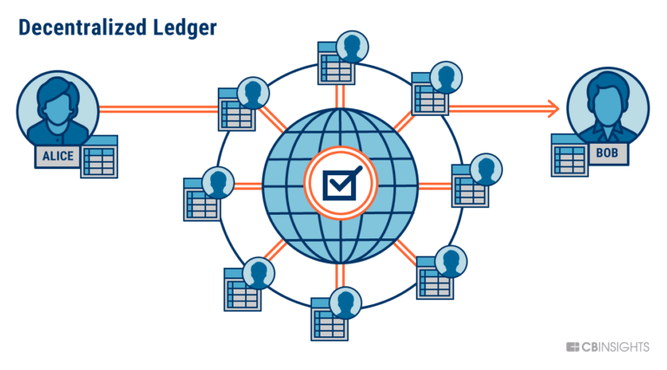

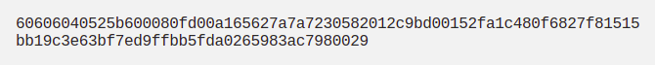
Smart Contracts
Pieces of software
Supposed to be immutable
Notes:
Smart Contracts are pieces of software that are deployed to the blockchains such as Ethereum and supposed to be immutable and tamper proof. It means if Alice puts a piece of a code or better to say bytecode in the blockchain, it cannot be changed in the future.

Slide 4
Immutable
A piece of software that you cannot change it!!!
Notes:
But a piece of software that cannot be changed is not compatible with update and upgrade concepts of software maintenance.

Slide 5

Immutable
A piece of software that you cannot change it!!!
It is worst in Blockchains Because code has control over money here
Notes:
In blockchains it’s even worse than traditional softwares because smart contracts have control over billions of funds in their costudy

Slide 6

What if the code is Buggy!
Hacker will drain all the fund
If possible
Notes:
And if a code is buggy what may happen? A hacker may find the way to exploit it and drain all the money.

Slide 7


What if the code is Buggy!
DAO Smart Contract
Notes:
This exactly happened in DAO incident in April 2016. And there was a race between White hackers and Blackhat hacker to steal or safe the funds.

Slide 8
Upgradeability is a Bug!
How ?! (immutability)
No way! We need upgradeability
Who Is responsible?!
Notes:
So No way we need upgradeability feature in smart contracts. But there is two main question raises in this regard that we try to answer in this paper.
The first one is How to deal with immutability and add upgradeability to smart contracts. And the second one is who will be responsible and decision maker for the changes of the system?
We answer the first question by studying different upgradeability patterns in the wild and give an evaluation of them. And then investigate for the agent responsible for the changes in the system A. K A admin

Slide 9
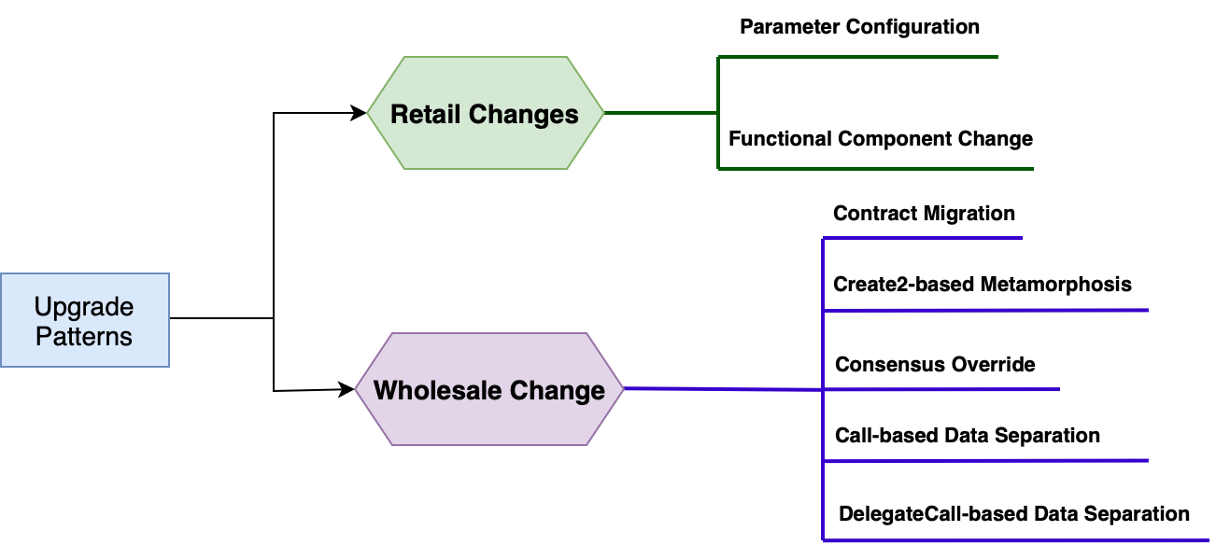
Upgradeability Patterns
Notes:
This is a big picture of different upgradeability patterns in Ethereum. Because The time is limited for this talk I cannot go through details of all different patterns but will explain them briefly. For more detailed explanation of each pattern I suggest to read the paper.
We classified different patterns into two main categories. Retail changes in which one can change a small pre-specified part of the Dapp. and Wholsale changes by which one can change the whole logic of the system.

Slide 10
Retail Changes
Parameter Configuration
Retail Changes
Notes:
The first method is parameter change. In parameter change there is some limited number of variables in the system design.
The logic of the system depends on these variables and Changing these parameters will lead to changes in the logic of the system.

Slide 11
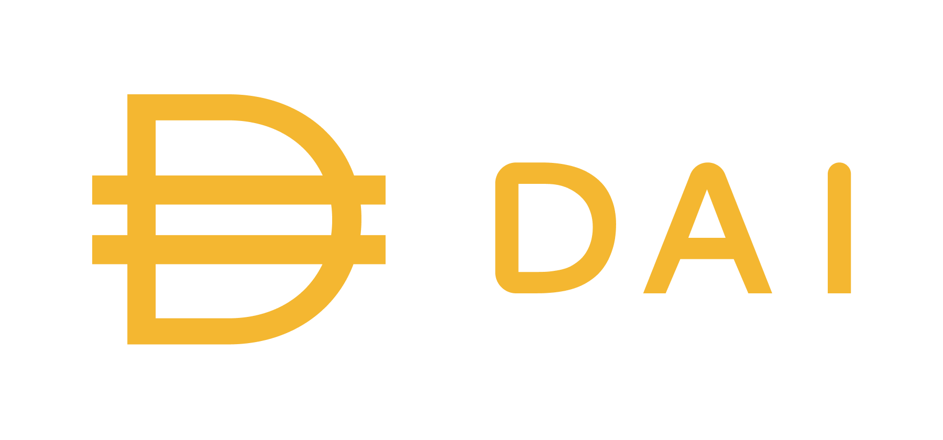
Parameter Configuration
Upgrade to control Demand and Supply of DAI
Stability Fee
Dai Saving Rate
Collateral Ratio
Notes:
For instance in Dai, there are different parameters such as stability fee that the admin can change, which results in controlling of demand and supply of dai.

Slide 12
Upgradeability Patterns
Parameter Configuration
Retail Changes
Functional Component Change
Notes:
The next method is Functional component change. In this method just one component of the system is changeable.

Slide 13
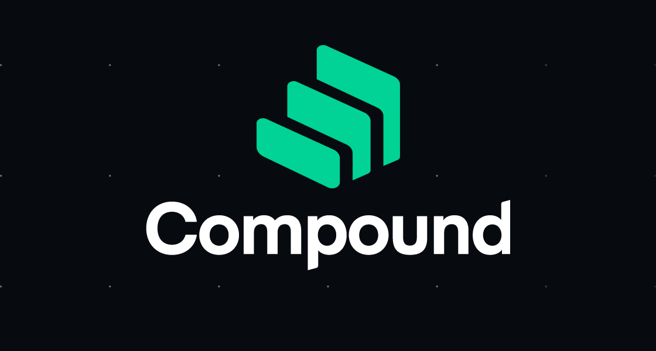
Functional Component Change
Another contract for calculations
Need a way to calculate interest rate
Notes:
For instance in compound protocol, which is a lending platform there is a need to calculate borrow and lending fees. This calculation is outsourced to another smart contract and if it decided to change the formula for fee calculations, admins can just deploy a new contract with the new logic and change the pointer to point to the new contract and change this component.

Slide 14
Pros and Cons
Pros
Simple to implement
Easy to audit
Cons
Cannot fix a bug
Cannot add/change Logic in Parameter Configuration
Cannot add new functionality in Component change
Notes:
The pros of using retail changes method to upgrade the system is: it is simple to design and easy to audit
Also the disadvantages are: the team cannot fix a bug. In parameter changes one cannot add new logic and in functional component changes team cannot add new functionalities

Slide 15
Upgradeability Patterns
Consensus Override
Wholesale Changes
Notes:
The next method is consensus override which is in wholesale change category.

Slide 16
Consensus Override
Immutability Enforced by Consensus
If Miners agree to suspend immutability:
Can change any contract’s Logic/Storage ….
The DAO fork
Any other incident?
Notes:
Blockchain specifications and rules such as Immutability is enforced by a consensus between miners or validators, both technically and socially. If miners decide to bypass the immutability and change the state of the blockchain, they can come up with an agreement and do that.
We had exactly the same event in Ethereum in April 2016 in DAO fork. There may be another same events in future in Ethereum or other blockchains

Slide 17
Upgradeability Patterns
Consensus Override
Wholesale Changes
Migration
Notes:
The next pattern is Migration plan

Slide 18
Migration (Social Upgrade)
Deploy a new contract
Migration
Collecting data from old version
Push data in the newer version
Notes:
Migration plan is as easy as deploying a new smart contract, collecting data/funds from previous version, and pushing them to the new version.
It also called Social upgrade because there isn’t any on-chain clue of the upgrade, and the team should reach out to the user to make them aware of the upgrade event.

Slide 19
Migration (Social Upgrade)
Deploy a new contract
2 different versions
Migration
Collecting data from old version
Cannot Fix a Bug
Push data in the newer version
Costly
Notes:
Migration plan is costly because of need of pushing data to the new version.
In most cases users are responsible to move their own data.
One cannot fix bugs in the older version. And at the end, 2 different versions of the Dapp will exist which are competitors.
As an example Uniswap V2 and V3 both are alive, and liquidity are splitted between them.

Slide 20
Upgradeability Patterns
Consensus Override
Wholesale Changes
Migration
Create2-based Metamorphosis
Notes:
The other method for wholesale changes is Create2 based metamorphosis

Slide 21
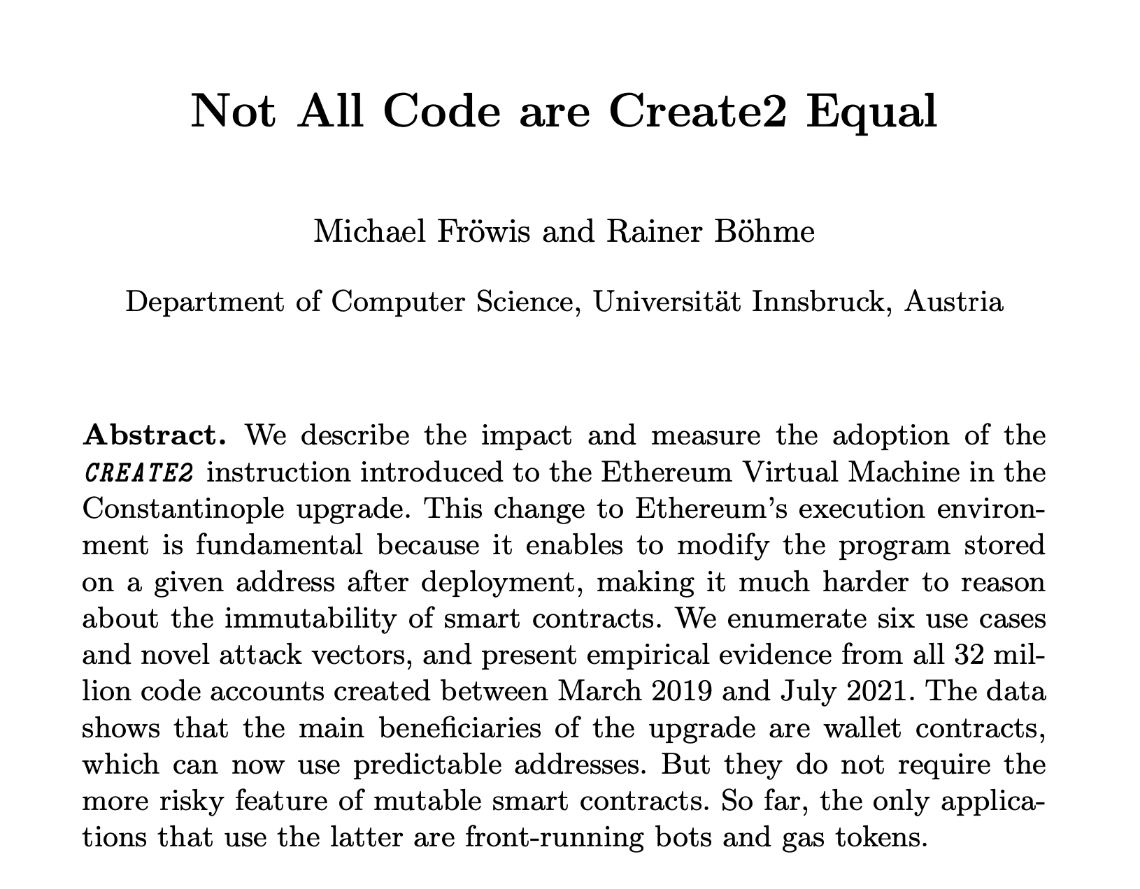
Create2-based Metamorphosis
Notes:
We won’t talk about the detail of this pattern. It is discussed in this article which will be presented in WTSC workshop.

Slide 22

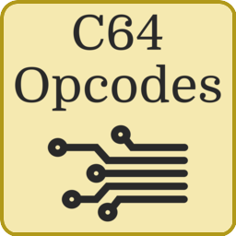
Create2-based Metamorphosis
Create2 Opcode
Factory contract
Notes:
But briefly: this pattern uses Create2 opcode in Ethereum
There is a Factory contract which uses create2 opcode to deploy a magic bytecode and this magic bytecode can generate new smart contracts. The key part here is that magic bytecode and create2 opcode.

Slide 23
Create2-based Metamorphosis
Self Destruct Opcode
Create2 Opcode
Factory contract
Notes:
Also these child contracts are removable using self-destruct. So in the upgrade event the admin will delete the desired contract.

Slide 24
Create2-based Metamorphosis
New Logic
New Contract
New Data
Create2 Opcode
Same Address
Factory contract
Notes:
Then they put a new contract in that specific place, but this time with a completely new logic.
The factory contract here is a specific type of factory called metamorphosis create2 based factory contract.
For more details bout this pattern I suggest to look into our paper.

Slide 25
Pros and Cons
Pros
Can change the whole logic
Can change the whole state
Nothing to change for deployers to add this pattern
User endpoint address is not changed
Cons
Self-destruct opcode removal
No way to keep state (self destruct deletes the state)
Downtime in upgrade events (because need to self destruct then deploy)
Notes:
The pros of using this method is you can change the whole logic and state with this pattern. Developer do not need to change the code to add this pattern. And user endpoint won’t change after upgrade
The disadvantage of using this method is that there is a huge debate on removing the self destruct opcode from EVM which is a pre-requisite for this method.
Also in all upgrade events, the state will be gone and there is no way to keep the state. Also there is a downtime in the upgrade event between the self destruction of the contract and putting a new contract.

Slide 26
Upgradeability Patterns
Consensus Override
Migration
Wholesale Changes
Create2-based Metamorphosis
Data Separation
Notes:
The latest method for upgradeability is data separation patterns

Slide 27
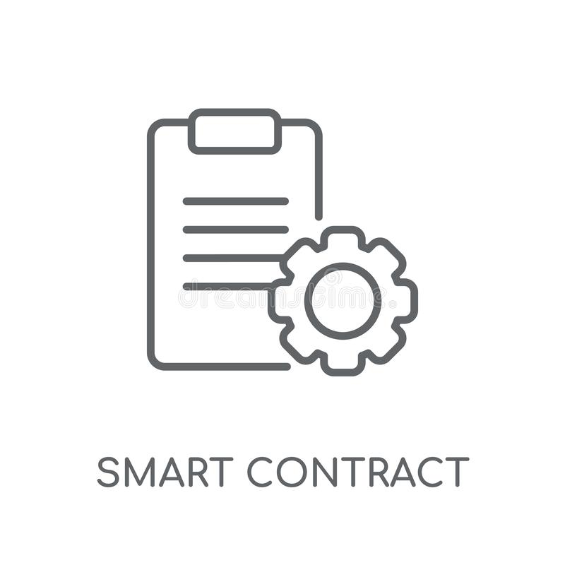
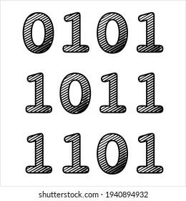

Data Separation
Logic
Storage
Notes:
In data separation pattern we divide the smart contract into two parts, one keeps the logic and the other keeps the data like data base

Slide 28
Data Separation
Logic
Storage
Change this part
Notes:
In upgrade event we can change the logic contract and keep the data

Slide 29
Data Separation
Communicate?!
Logic
Storage
Call Opcode
DelegateCall Opcode
Notes:
The most important thing here is how these two contract are communicating. There are different ways in ethereum that contracts are communicating, but the most widely used two ones, are call and delegatecall opcode

Slide 30
Upgradeability Patterns
Call-based
Data Separation
Notes:
So there is a call-based and delegate call based, data separation pattern

Slide 31

Call based pattern
Send transaction
Call
Getter function
Setter function
Logic
Storage
Do the logic
Notes:
In this type, users send transaction into the logic contract and the logic contract do the logic, Whenever it needs a data, it will call a getter function of the storage contract to fetch that data.
If it needs to change a state, it will call storage contract’s setter functions. Storage contract will use access control and just let the logic contract to change the its state.

Slide 32
Call based pattern
Change Logic address
Old Logic
Storage
New Logic
Notes:
In case of upgrade, admins will deploy a new logic contract, and change the access control in the storage contract to define the new logic contract for storage contract. This is how the upgrade will be done in this pattern

Slide 33
Call based pattern
No need for Data Migration
Hard for developers to change their codes and add this pattern
Hard to implement for complex data structures
The address will change
Break Composability
Not user friendly
Need to aware all services about the change
Deal with the old version
Notes:
In call-based patterns there is no need to migrate data. But it is hard for developers to add this pattern to their codes, because of need of splitting logic and storage part of the code. It will be worse if the contract needs complex data structures such as mapping or structure.
Also the end point address will be changed. It will break composability, it is not user friendly because each time users must use a new address, and also at the end developer team must deal with the old version.

Slide 34
Upgradeability Patterns
Call-based
Data Separation
Delegate Call-based
Notes:
The next method is delegatecall based data separation pattern

Slide 35
Delegate Call based pattern
Send transaction
Delegate call
Storage (proxy)
Logic
(Implementation)
Delegate call preserves the context
Similar to copy pasting (not the same)
Notes:
Here users will send transaction into storage contract or proxy contract. The proxy will delegatecall into the logic contract also known as implementation contract.
Delegatecalling keeps the context and it is very similar to copy pasting that specific part of logic into the contract, and run it in its context.

Slide 36
Delegate Call based pattern
Old Logic
Send transaction
Storage (proxy)
Change target address
New Logic
Notes:
In the upgrade event, admins must deploy a new contract and change the target address inside proxy, and let it know that it should delegatecall into a new address

Slide 37
Pros and Cons of Proxy patterns
Pros
Can update the whole logic
No need to migrate data
Easy to add this pattern to regular code
User endpoint not changed
No downtime during upgrade
No need to deal with two Dapps at the end
Notes:
This is why this pattern is popular.

Slide 38
Pros and Cons of Proxy patterns
Cons
Gas overhead for tx
Risks due to using DelegateCall opcode
Function selector clashes
Storage layout clashes
No constructor in Implementation contract
Cannot change the state (data)
Changing state of contract needs Migration plan
Notes:
There is a gas overhead because of indirection happens between logic and storage contract

Slide 39
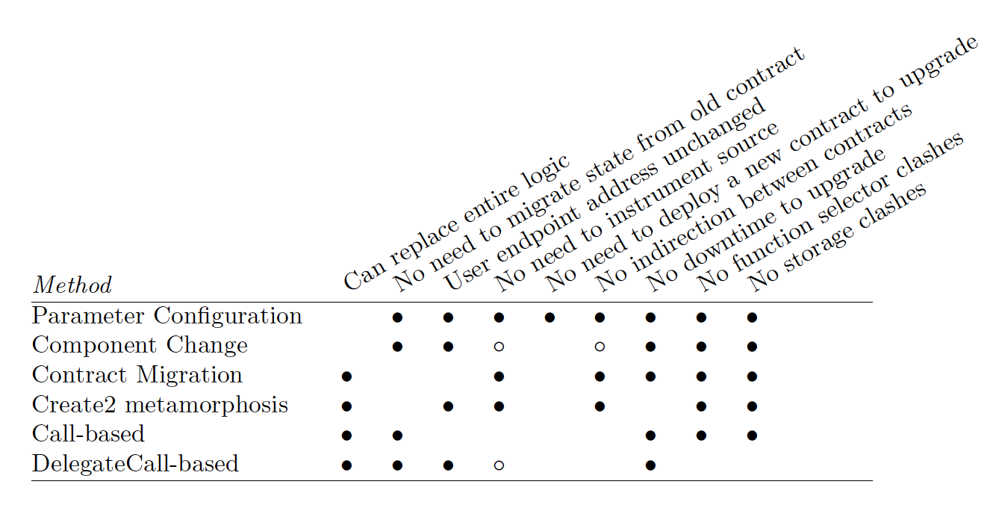
Evaluation of different methods
Notes:
We summarized these methods and evaluate them in the paper. I suggest reading the paper and the appendix of the paper where we compared different methods from designers point of view.

Slide 40
Measurement Study
Find contracts that uses Delegatecall-based patterns.
It is mostly known as Upgradeable Proxy Patterns
Notes:
Next part of the paper is measurement study. Our Main Goal in this part is to find contracts that are using delegate call based pattern in the Ethereum blockchain.

Slide 41
Delegate proxy
Storage (proxy)
Implementation Contract
Send transaction
address imp;
fallback () {
delegateCall to imp Forward the message
}
function upgrade (new_address){
imp = new_address;
}
Notes:
To give more details about proxy patterns, the code of proxy is similar to this. There is a target address we name it imp here. There is a fallback function inside proxy.
fall back function is a specific type of function. If the transaction calls a function that does not exists in the contract, fallback will be executed. In the proxy contract inside fallback, the whole message will be delegated call into a target address.
Also because we need a way to upgrade the system, there is an upgrade function inside proxy which lets the admins to change the target address, and change imp variable.

Slide 42
UUPS Proxies
Storage (proxy)
Implementation Contract
Send transaction
address imp;
fallback () {
delegateCall to imp Forward the message
}
address imp;
function upgrade (new_address){
imp = new_address;
}
Notes:
Changing the target address can be done also using implementation contract. This type of proxy is called UUPS proxy and the upgrade function is reside inside the implementation contract.

Slide 43
Measurement Study
Request to replay transactions inside each block
Data of Transactions for 1 year
Need to access to a full Archival Node
Transaction Traces
Notes:
To find the delegatecall based smart contracts, we use data of 1 year by getting the transaction traces of two million blocks of the Ethereum blockchain.

Slide 44


Measurement Study
Sub-traces
DelegateCall??
Same input with previous sub-trace?
Sub-traces
Proxy
Transaction Traces
Sub-traces
Notes:
Transaction trace is an aggregated data about the execution of transactions, and consists of sub traces.
Each sub trace has the data for that specific action, and there will be a calltype in the sub-trace if a smart contract communicate with another one in that sub-trace.
So we picked transaction traces and search in the sub-traces to find if a delegate call happens on them. We then check if the data of a sub-trace is equal to its previous sub-trace.
If yes it means that the transaction passed a fallback function which delegatecalls the whole data into a new address, which is a proxy contract.

Slide 45
Measurement Study
Sub-traces
DelegateCall??
Same input with previous sub-trace?
Sub-traces
Proxy
Transaction Traces
Sub-traces
Upgradeable?!
Notes:
But not all proxy contracts are upgradeable right?

Slide 46
Delegate proxy
Storage (proxy)
Send transaction
address imp;
function upgrade (new_address){
imp = new_address;
}
fallback () {
delegateCall to imp Forward the message
}
Yes
Upgradeable
Can we change Imp address?
No
Forwarder
Notes:
We should be sure that there is a way in the code that let admins change the target address. If there is a way then the proxy is upgradeable, and if not it is a simple forwarder contract.

Slide 47



Measurement Study
Check for the upgrade function
Decompile
Yes
No
Upgradeable
Notes:
So we should decompile the bytecode of the proxy and search for the upgrade function.
If we found the upgrade function it means the proxy is upgradeable.
For the details of the implementation and how we find the upgrade function, please take a look at our paper.

Slide 48

Beacon Proxies
Check if the target address comes from an External Call
Decompile
Yes
Proxy Contract
No
Beacon Proxy
Notes:
For the remained proxies, we check if the target address comes from an external call.
If yes it means that the proxy is using beacon pattern, and each time calls the beacon contract to get the target address from it.

Slide 49
UUPS Proxies
Storage (proxy)
Implementation Contract
Send transaction
address imp;
fallback () {
delegateCall to imp Forward the message
}
address imp;
function upgrade (new_address){
imp = new_address;
}
Notes:
But as we discussed before, it is possible that the upgrade function resides in the implementation contract, and not the proxy

Slide 50
UUPS proxies
Try to find the upgrade function in implementation contract
Decompile
Yes
Implementation Contract
No
UUPS proxy
Notes:
So to find UUPS proxies, this time we decompile the implementation contract instead of the proxy, and check to find the upgrade function inside it. If we found the upgrade function, it means the proxy uses UUPS pattern.

Slide 51
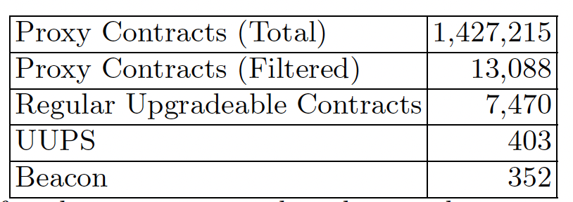
Results
Notes:
In this research we found 1.4 millions of proxies. We filtered them to have proxies that has unique implementation contract.
We filtered them because there are some Dapps like opensea, that create a proxy for each user and if we don’t filtered them, then it will be counted by number of users and not number if upgradeable Dapps.
At the end totally we fund 7.4k regular upgradeable contracts, 403 UUPS contracts and 352 beacons.

Slide 52
Now: Who’s responsible?
Externally Owned Address (EOA)
1 person decision
Multi Signature Wallet
M out of N person
Decentralized Governance
Governance token
Threshold on acceptance of a proposal
Notes:
We answered the first question on how to add upgradeability.
Now let's take a look into the question : who is responsible for the decision making of upgrades. There are three different types of admins. An EOA, A multi signature and a decentralized governance scheme

Slide 53
Now: Who’s responsible?
Externally Owned Address (EOA)
1 person decision
Multi Signature Wallet
M out of N person
Decentralized Governance
Governance token
Threshold on acceptance of a proposal
Admin
Proxy Admin
Notes:
There is also another way in which a proxy could be an admin. This type just adds a level of Indirection, and at the end one of the mentioned three types will be admin.

Slide 54
Who is the decision maker?!
Externally Owned Address (EOA)
1 person decision
Multi Signature Wallet
M out of N person
Decentralized Governance
Governance token
Threshold on acceptance of a proposal
Notes:
The first two types are very dangerous specially the EOA type of admins.
Because in these types, 1 or limited number of persons can decide and change the whole logic of the code, and may try to steal the whole funds under control of the smart contract.
So we try to find these admin types in the proxy contract we found from our measurements.

Slide 55
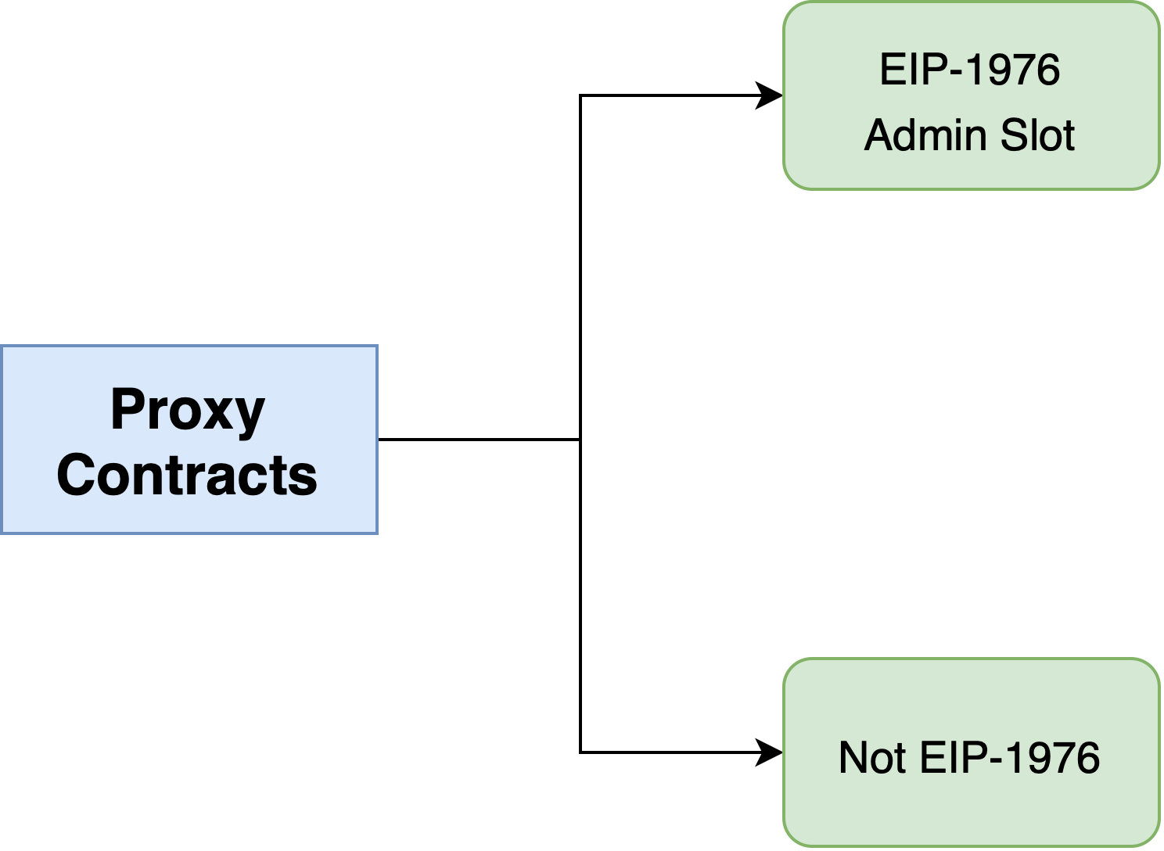
Admin Types
EIP-1967 Admin Slot
Not EIP-1967
Notes:
The first step is to find where the address of the admin is saved, in the smart contract storage.
If the contract follows EIP-1967, then the address is saved in a storage slot, that is defined in this standard.
If it does not follow this standard we first should find the slot number in which admin address is saved.

Slide 56
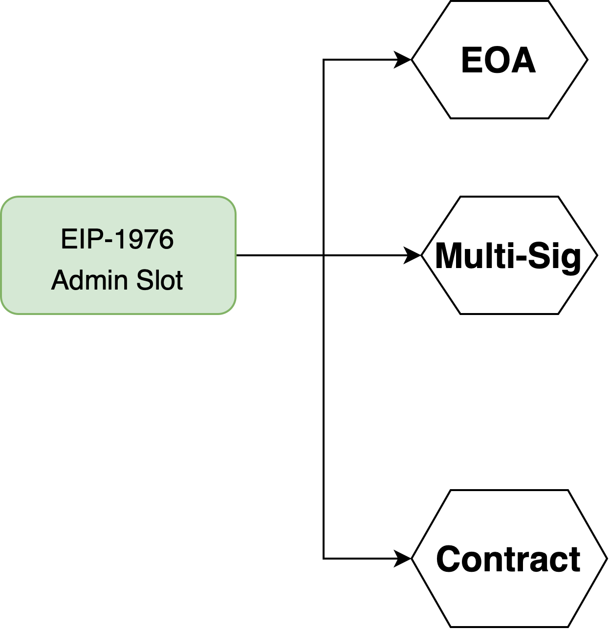
Admin Types
Using eth_getStorageAt method
No contract Code Found
EIP-1967 Admin Slot
Gnosis-Safe contracts
Others
Notes:
Here in EIP-1967, because we know the storage slot, we use eth-getStorageAt method of an Ethereum node, to find the address variable that is saved in this storage slot.
This address is our admin of the proxy, and can be one of these three types: EOA Multi sig or another type of contract.
If No code is inside that address, it means the admin is an EOA and not contract. We can check for the code of the address using eth-getCode method of an ethereum node.
Otherwise we get the bytecode of the address and check if it is a Multi-sig contract.

Slide 57
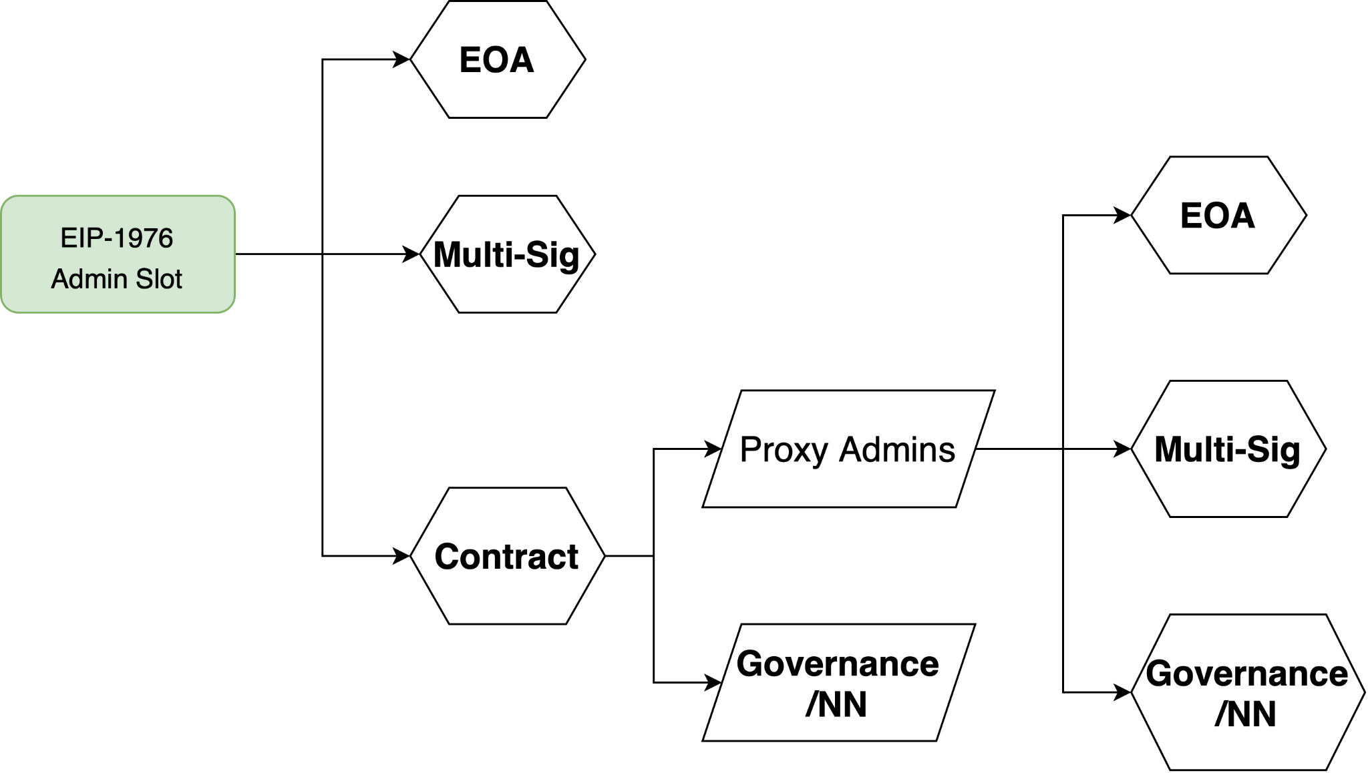
Admin Types
EIP-1967 Admin Slot
Notes:
If it isn’t a multi-sig we checked if it is a proxy admin contract. if not we tagged it as Governance or other types.
For proxy admins we do the same thing from step 1 to find out the admin type.

Slide 58
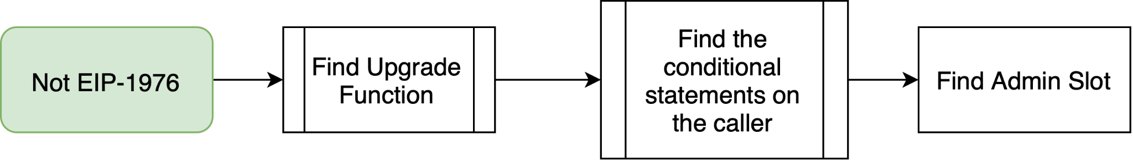
Admin Types
Not EIP-1967
Notes:
For non-EIP-1967 contract we should find the storage slot in which the admin address is saved.
For this purpose, we first find the upgrade function, then check the access control inside this function to find out which address is authorized to call this function. This address is our admin address.

Slide 59
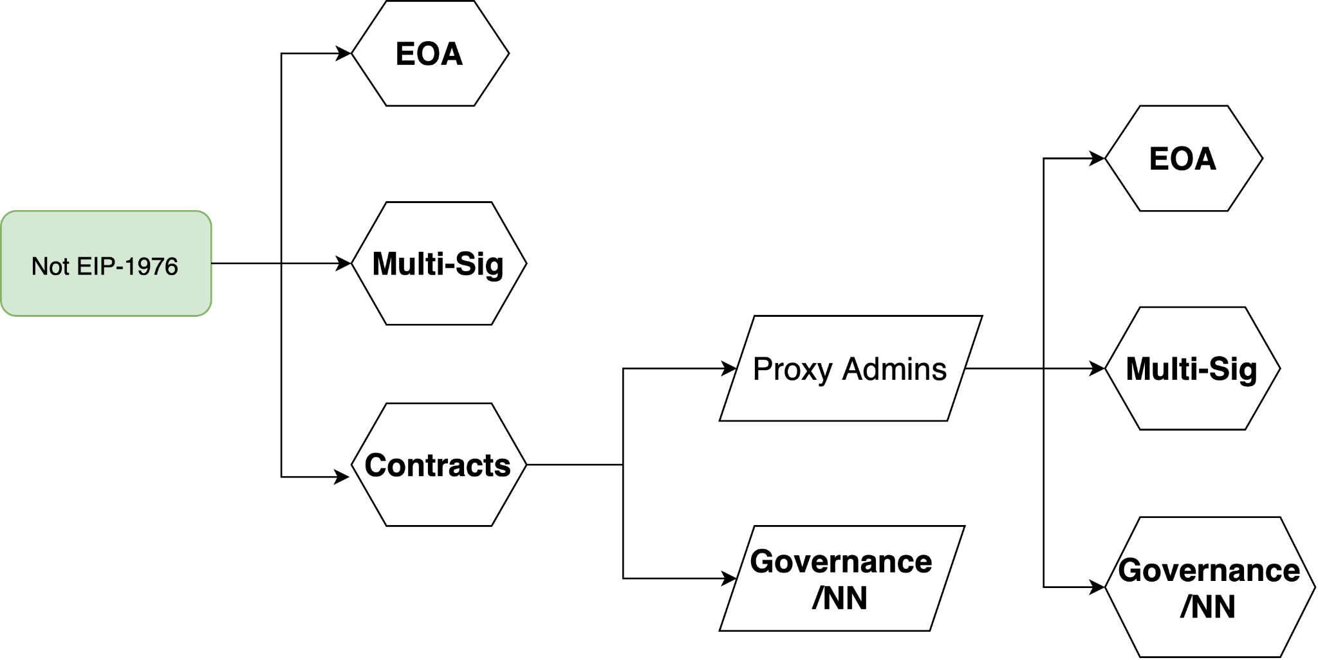
Admin Types
Not EIP-1967
Notes:
The rest is similar to what we had in EIP-1967 class. We find the admin type for them as well.

Slide 60
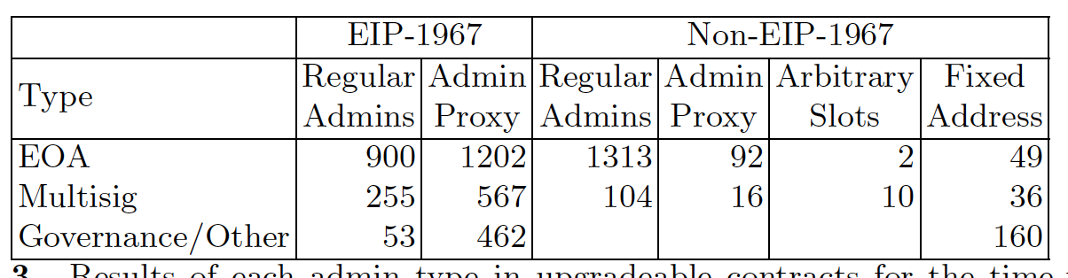
Admin Types-Results
EOA : 3558
48%
Multi-Sig : 988
13%
Governance/Other: 988
Notes:
This is the total result which you can find in Table 3 of the paper.
Totally out of 7.4k regular proxy contracts, 48 percent of them are controlled by just an EOA, and 13 percent by a Multi-sig wallet.
This is an alarm to the Ethereum community and ecosystem.

Slide 61
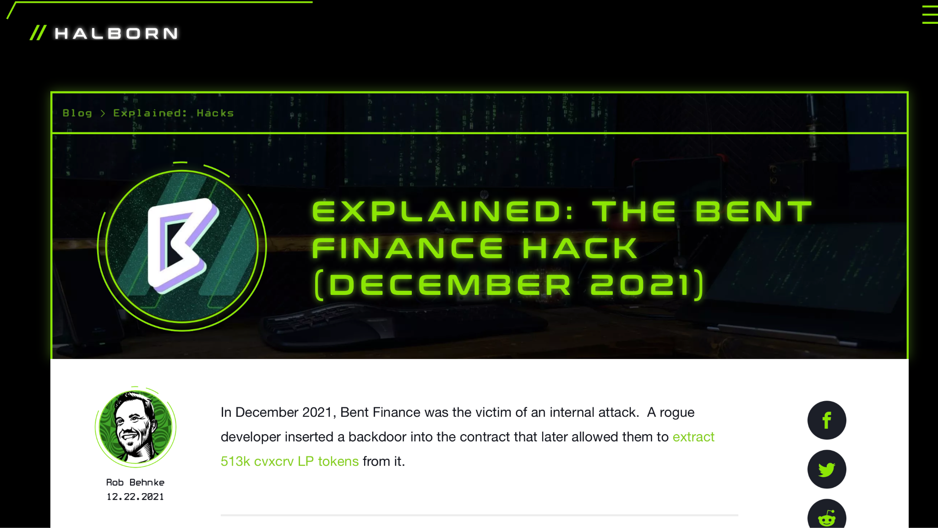
Admin Types-Results
EOA : 3558
48%
Multi-Sig : 988
13%
Governance/Other: 988
Notes:
EOA admins are very dangerous because a single private key can decide to change the whole logic of the system.
A malicious or compromised EOA admin can decide to stop the Dapp, or even steal the fund.
There was an incident on bent finance protoco in December 2021l that the admin upgraded the system into a backdoored version and take benefit from it.

Slide 62
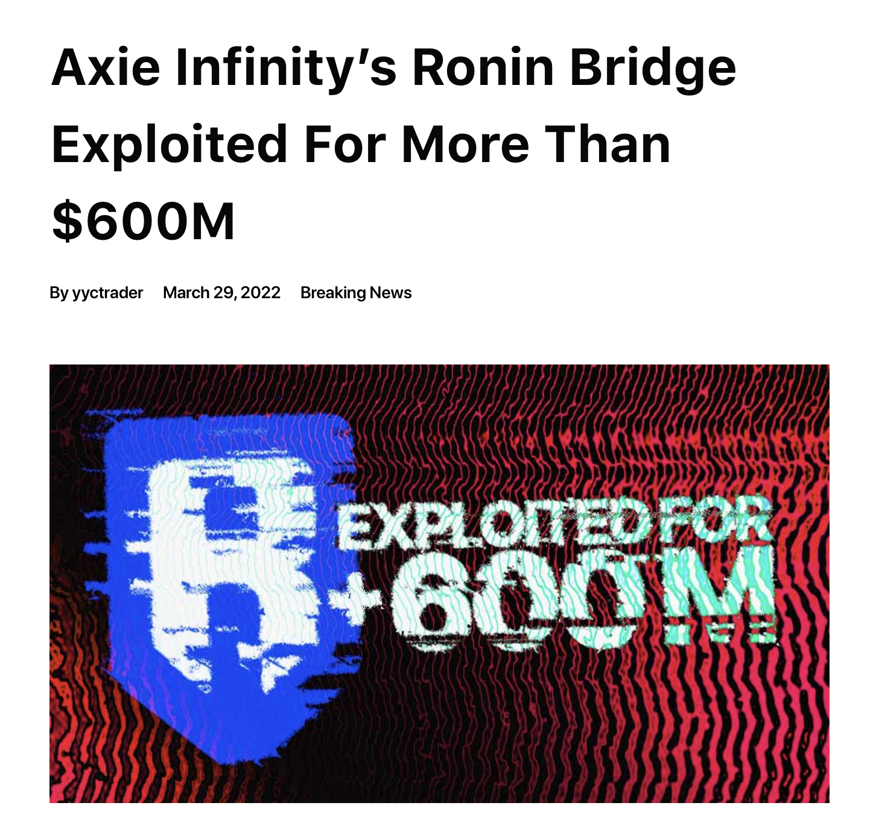
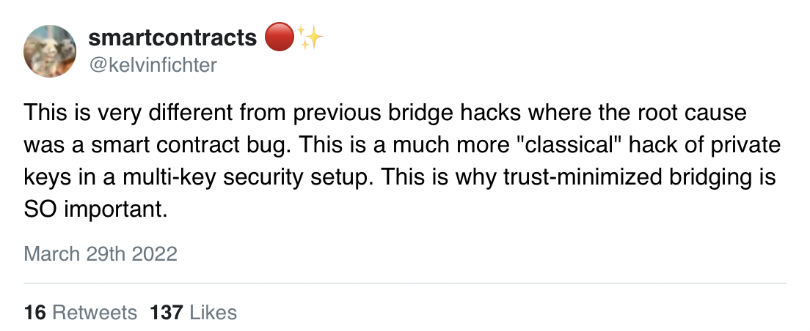
Admin Types-Results
EOA : 3558
48%
Multi-Sig : 988
13%
Notes:
However the community consider using a multi-signature admin as a safe option, we want to say that in this scenario a limited number of persons can decide to take control over the system.
The other problem is that because the addresses on ethereum blockchain is sodu nomus, nobody can proof the identity behind addresses of the multi signature. So, a malicious team can keep enough keys in their hands, to sign any transactions they need, and in this scenario, the multi signature is equal to an EOA.
There is a recent incident on Ronin bridge that based on their announcement 5 private keys are leaked and the attacker signed transactions with the multi-signature wallet and steals the funds.

Slide 63
Take-Aways
Immutability is Oversold
Upgradeable contracts
50% of admins are EOA and 14% are Multi-Sig
Consensus Override is still possible (L1 and L2 both)
Our model is generic and not stick into library artifacts
Notes:
The key take-away of this research is that immutability, decentralization and trustlesness is oversold and not true because of widely usage of upgradeable smart contracts. Also more than 60 percent of these contracts have EOA or multi sig admins.
Also we want to emphasis that consensus override is still a choice of upgrading a contract in a catastrophic events. This may happen on L2 platforms such as rollups if anything bad happens to those systems.
Also it worths mentioning that the mechanism we used in this research to find Proxy patterns and Admins are generic and not just stick into artifacts of a specific library like openzepplin libraries.

Slide 64


Thanks!
Get in Touch:
@Greatsaoshyant
mehdi.salehi@concordia.ca
Notes:
Thank you so much You can get in touch with me if you have any suggestions or questions. You are more than welcome to send me an email or ping me on twitter.

